Slide 1
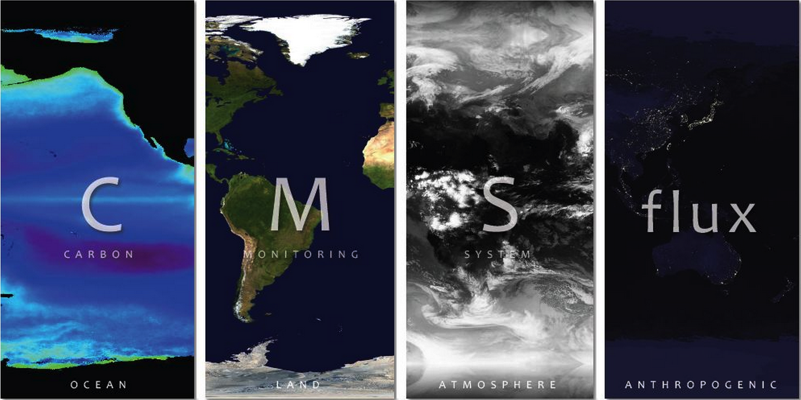
Attribution of the Atmospheric Growth Rate 2011-2010

Slide 2


Carbon Monitoring System Flux Pilot Project
http://carbon.nasa.gov
CMS team:
Kevin Bowman, Junjie Liu, Nicholas Parazoo, Meemong Lee, Dimitris Menemenlis, Holger Brix, Joshua Fisher, Christian Frankenberg
Jet Propulsion Laboratory, California Institute of Technology
Joint Institute for Regional Earth System Science and Technology, University of California, Los Angeles
Steven Pawson, Lesley Ott, James Collatz, Watson Gregg, Zhengxin Zhu, Randy Kawa, Cecile Rousseaux
NASA Goddard Space Flight Center
Chris Hill, Mick Follows, Stephanie Dutkiewicz
MIT
Scott Denning, Kathy Haynes, Ian Baker
Colorado State University
Kevin Gurney
Arizona State University
Gregg Marland, Eric Marland, Chris Badurek
Appalachian State University
Daven Henze and Nicholas Bousserez
University of Colorado, Boulder
© 2013 California Institute of Technology. Government sponsorship acknowledged

Slide 3
Atmospheric CO2 Growth Rate
2010: 2.45 ppm yr⁻¹
2011: 1.84 ppm yr⁻¹
The atmospheric growth rate of CO2 in 2010 was about 33% higher than 2011.
Why?
What are the processes driving those differences?
What are the spatial drivers of the CO2 growth rate?

Slide 4
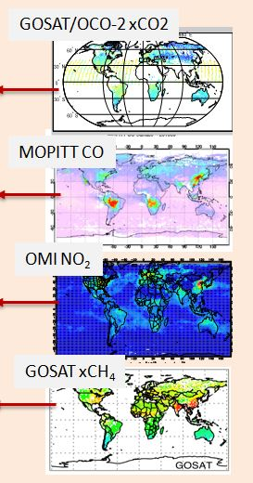
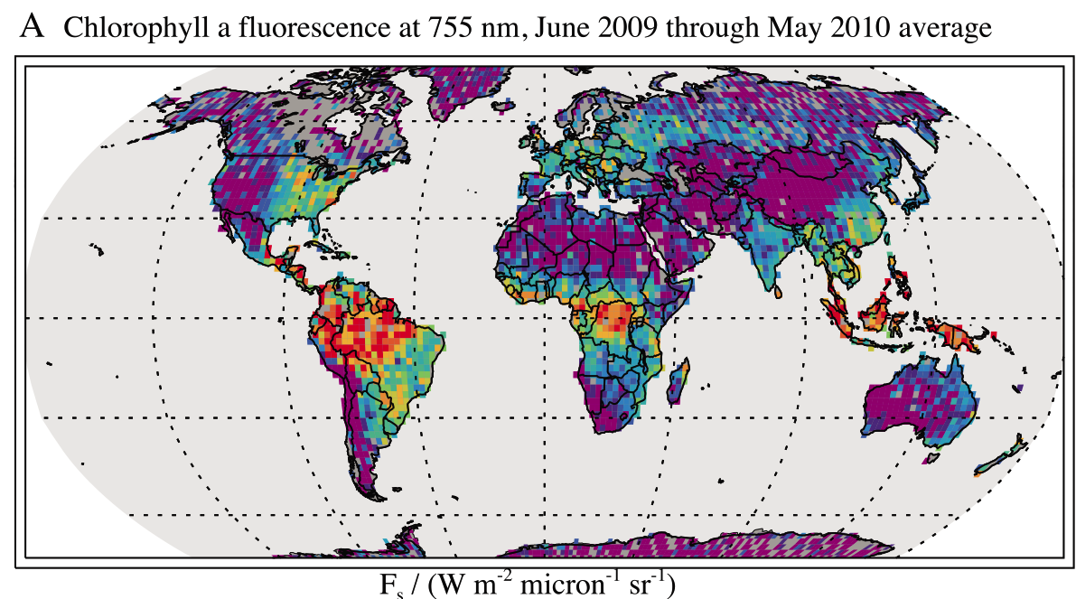
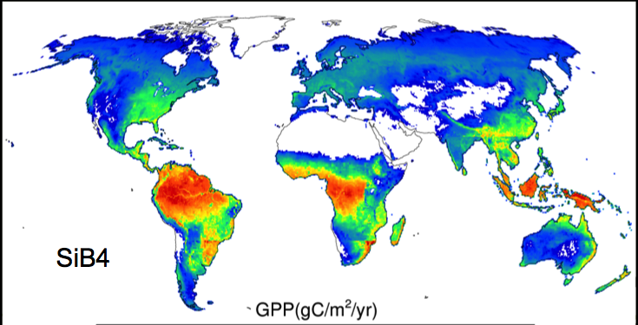
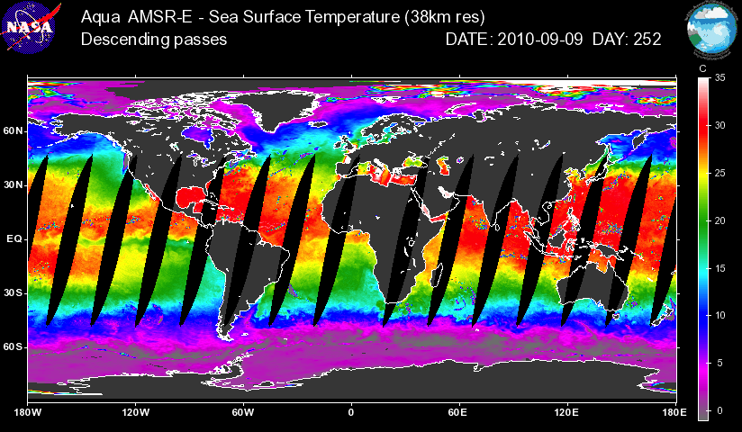
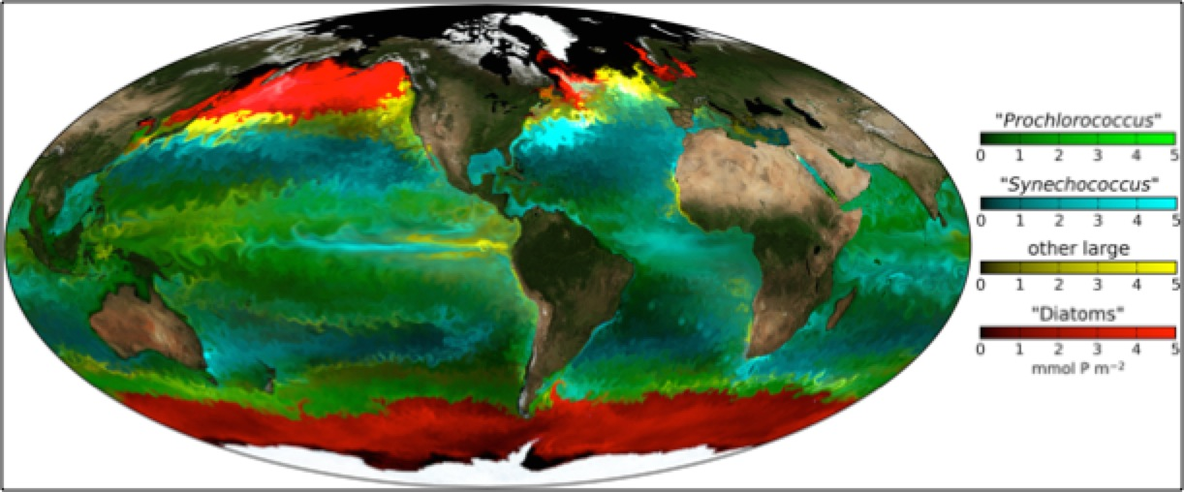
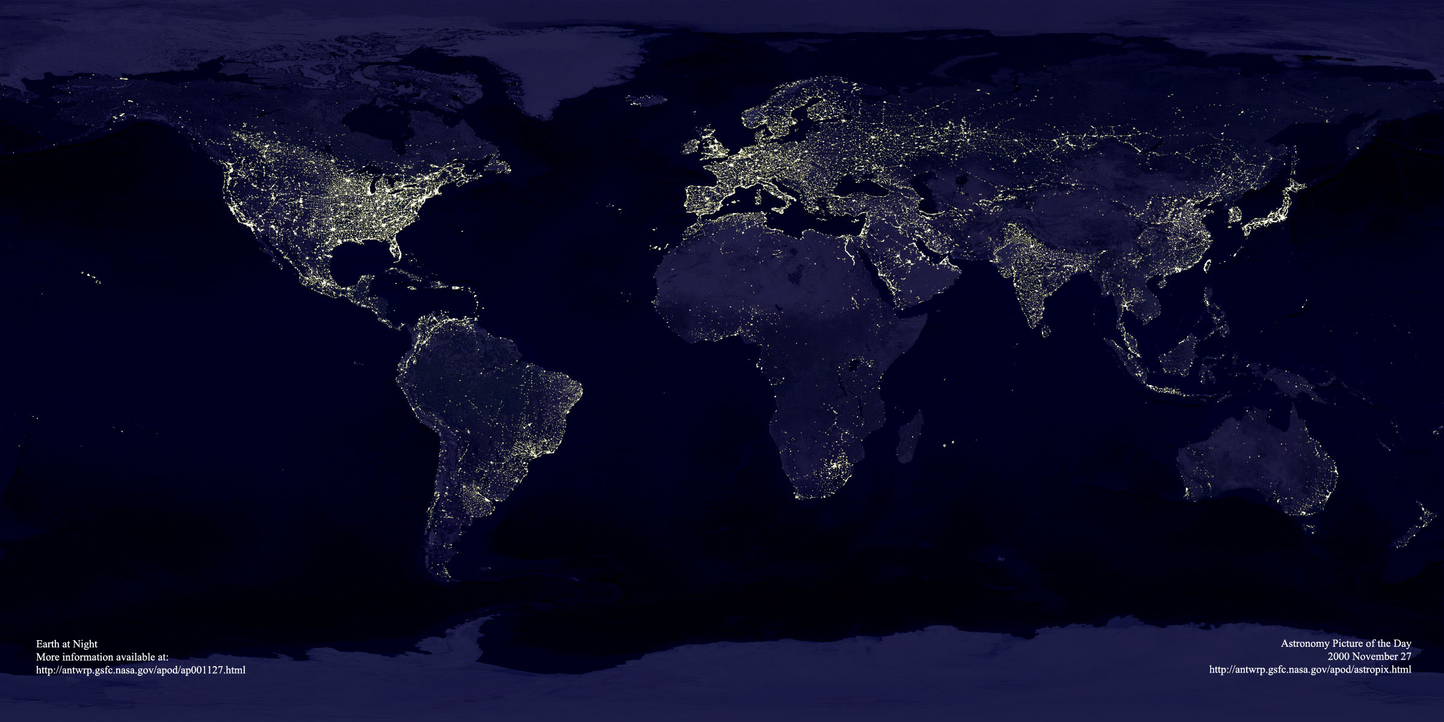
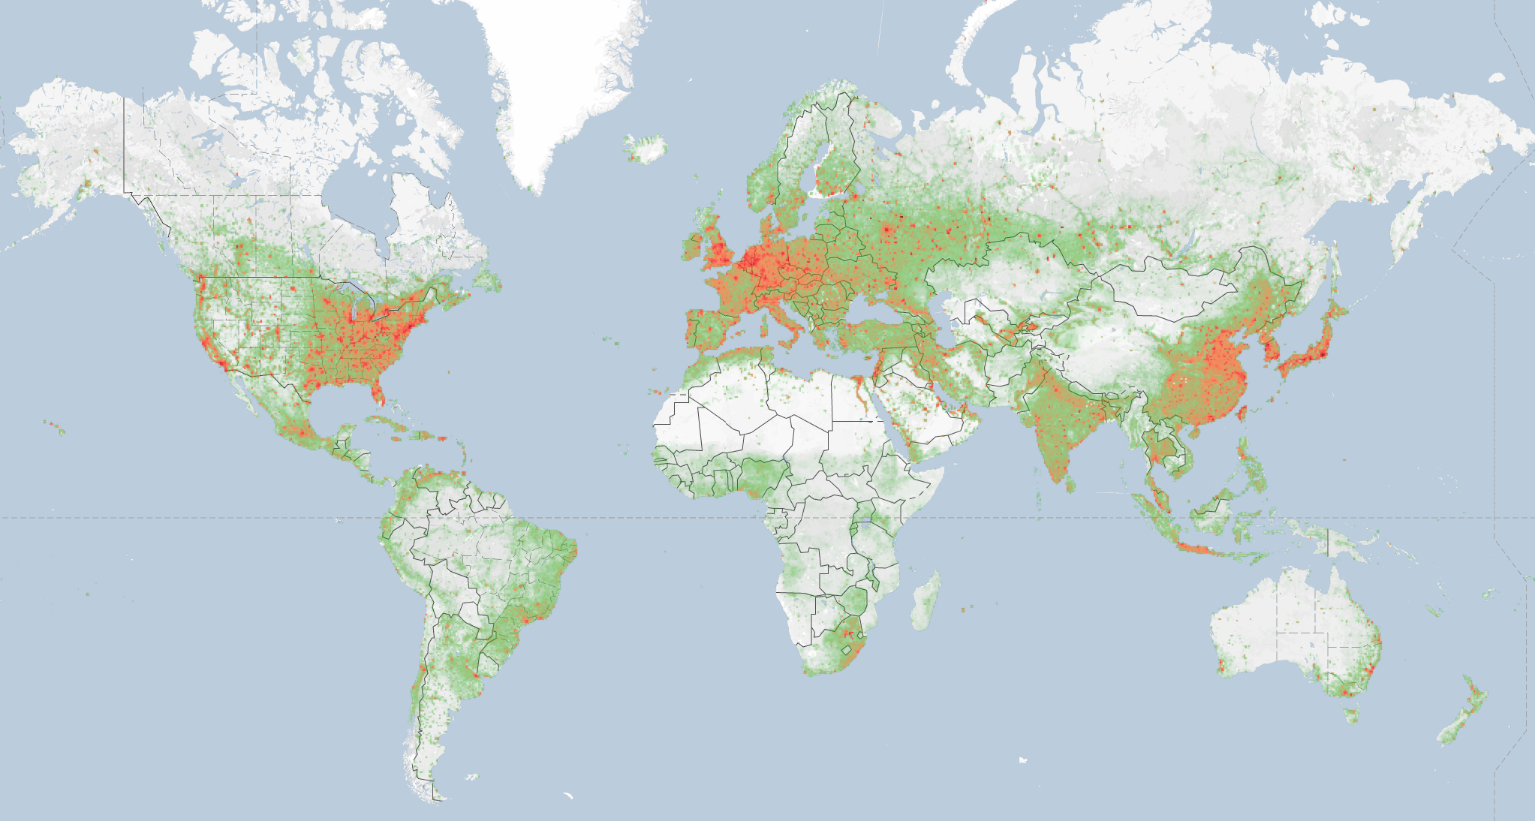
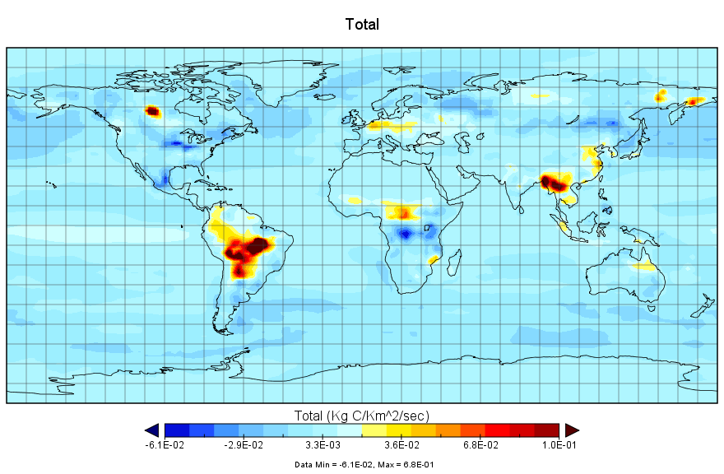
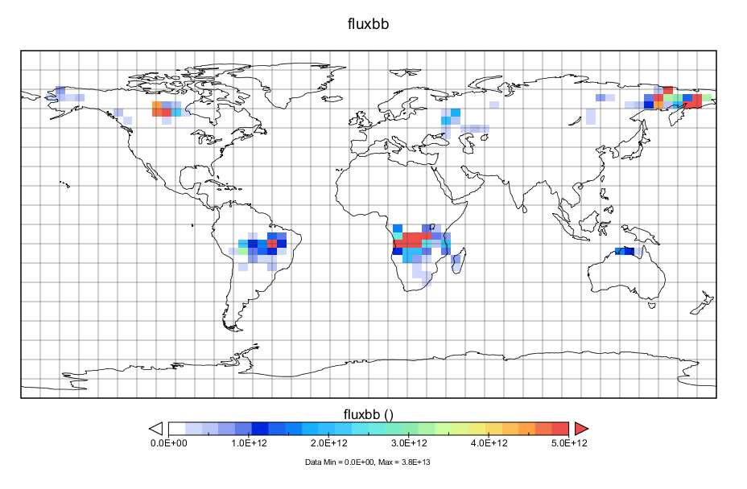
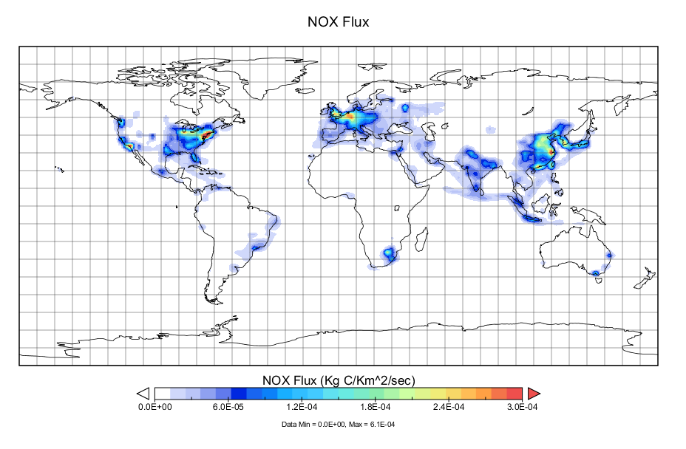
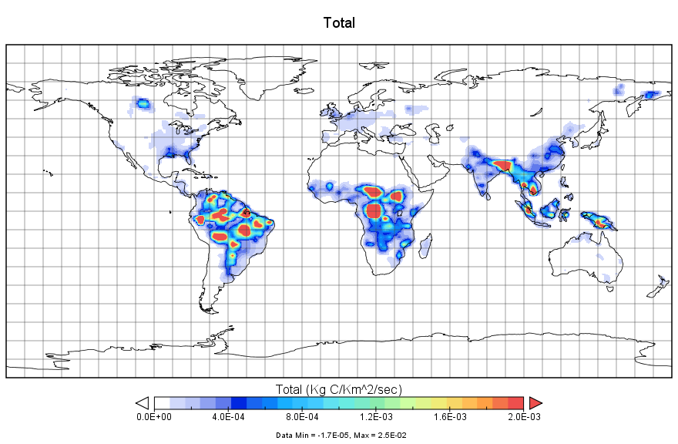
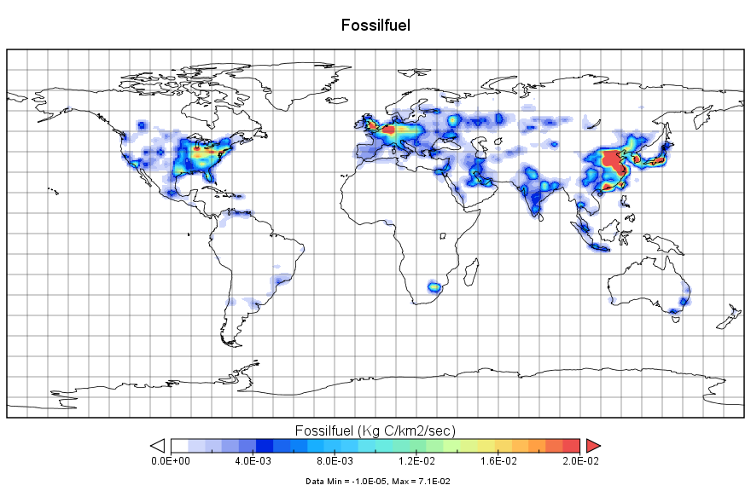
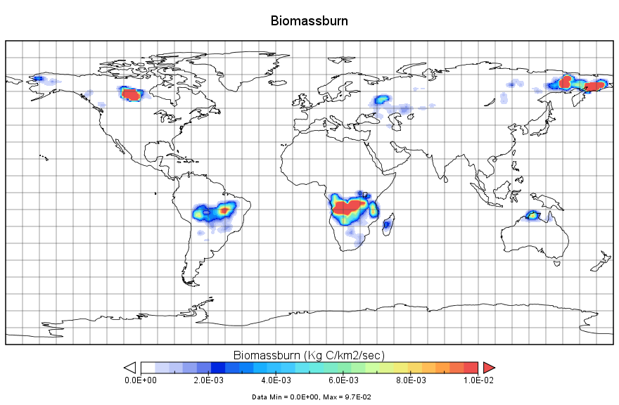
“Bottom-up”
CMS-Flux Framework
“Top-down”
Surface
Satellite Data
Carbon Cycle Models
Chemistry Transport Model
Atmospheric
Satellite Data
Terrestrial
Ocean
Forecast
Surface fluxes and uncertainties
Observations
Human
Inverse modeling
Reconciliation
Top-down estimates
Total CO₂
NO₂
Total CH₄
CO
Fossil Fuel- NO₂:CO₂
Combustion CO:CH4:CO₂
Posterior fluxes and uncertainties
Attribution
Notes:
GEOS-Chem has a rich history of use in understanding atmospheric composition and the inference of surface fluxes.

Slide 5
Changes in total flux 2011-2010
Basu et al, 2014
Gatti et al, 2014
Poulter et al, 2014

Slide 6
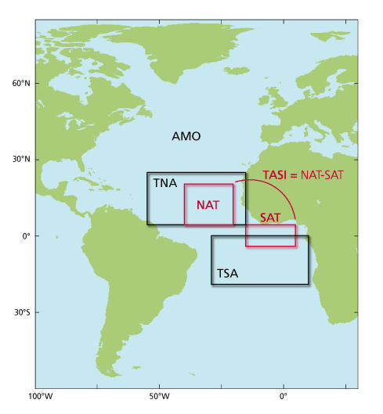
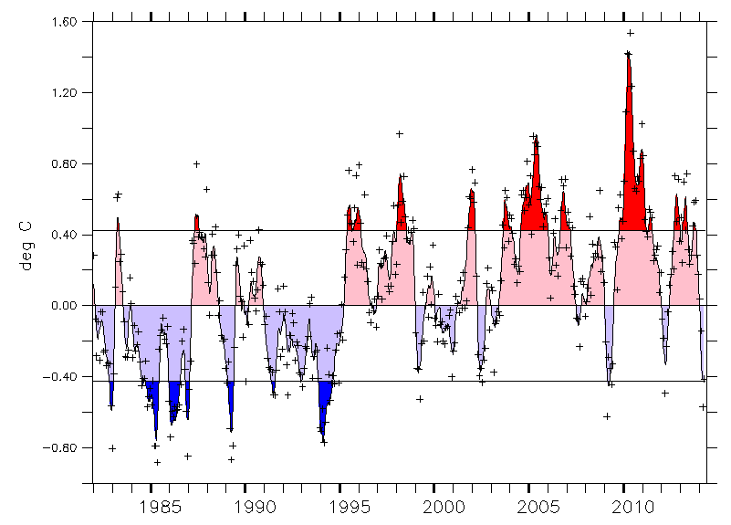
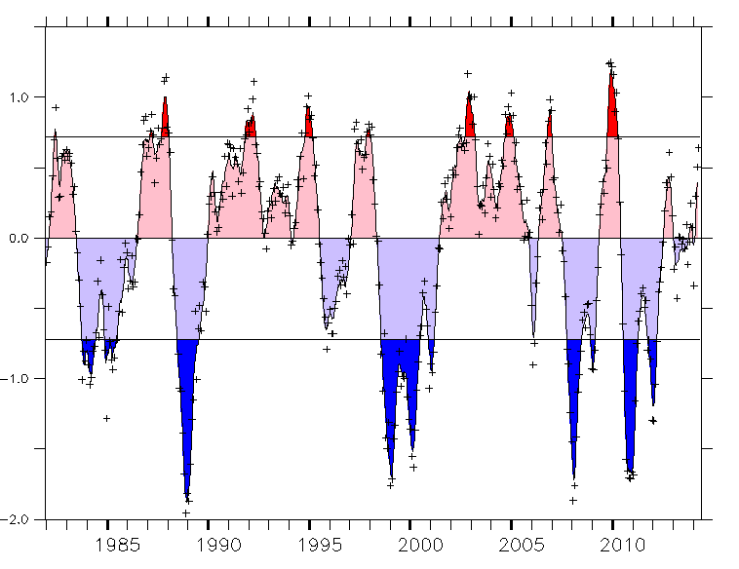
Drought and the Tropical North Atlantic
TNA
The tropical North Atlantic experienced
a record-breaking SST anomaly >1.5°C.
Consequence of a strong Central-Pacific “Modoki”
El Nino amplified by a strong and persistent negative phase of the North Atlantic Oscillation (NAO) (Hu et al, J. Climate 2011)
Shifted ITCZ north leading to a dramatic Amazonian drought (Lewis et al, Science, 2010)
El Nino 4.0

Slide 7
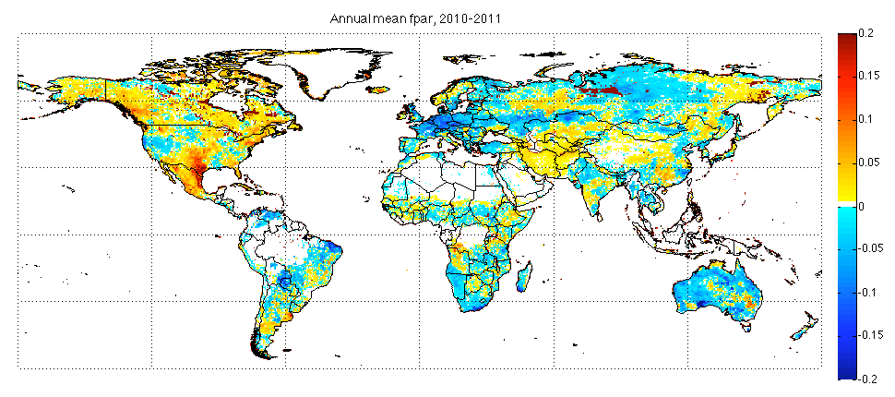
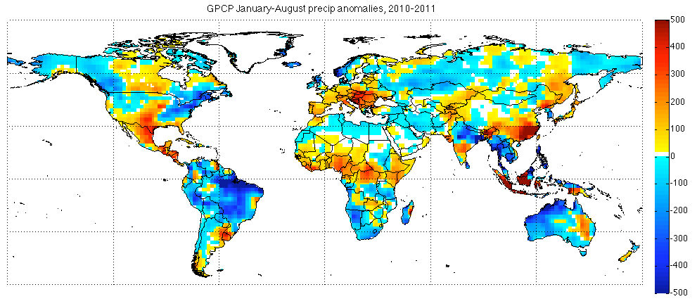
Environmental context
CMS-Flux Terr.+BB 2011-2010
AVHRR Annual FPAR anomaly 2010-2011
FPAR
GCPC Jan-Aug precip anomaly 2010-2011
Precipitation and FPAR anomalies in 2011 relative to 2010:
Mexico—low FPAR and preci
SE Asia—exact opposite situation
Australia—record precipitation and high FPAR
Brazil—high precip
Southern Africa—moderately high precip and fpar
Precipitation

Slide 8
GPP-Solar induced fluorescence
Solar induced fluorescence is a direct measure of photosynthetic activity (e.g., Porcar-Castell et al, 2014)
Parazoo et al, GCB, 2014 developed an inverse method to estimate GPP from satellite SIF and TRENDY models
f(β)=GPP(x,y,t) = β_{GPP} (x,y,t) * GPP_{pr}(x,y,t)
y: Inferred GPP (Fluorescence scaled to MPI)
R: GPP Uncertainty (Measurement Error)
P: Prior Uncertainty (TRENDY)
β_{b} Prior Scale Factor (CASA or JULES)
GPP
Frankenberg et al 2011
Fluorescence

Slide 9
Respiration: combustion
Measurements of Pollution in the Atmosphere
Carbon monoxide is a by-product of incomplete combustion.
MOPITT provides CO verticals with near surface sensitivity.
CMS-Flux estimates CO from MOPITT and converts to CO₂
CO₂ from biomass burning is calculated from CO/CO2 ratios (Andreae and Merlet, GBC, 2001)
Emission factors are a function of dry mass (given) and burning efficiency, which is a function of plant function type.
Emission factors

Slide 10
Flux decomposition
Atmospheric growth rate driven by comparable reduction in combustion and increase in net biome production (NBP) along with ocean (from El Nino-to-La Nina)
NBP driven by an increase in GPP
but a larger decrease in respiration
What about the regional scale?
GPP Casa-SIF used for NPB

Slide 11
Brazil
Brazilian biomass burning accounts for more than half of global BB change
Modest negative reduction in total flux implies positive NBP
GPP is positive-→Rh must compensate
  Mortality (Saatchi et al, PNAS, 2013)?
  Disagreement between Casa-SIF and Jules-SIF
    OCO-2 could resolve discrepancy

Slide 12
Mexico
Mexican total flux increased growth rate at comparable rate as Brazil
GPP dominates NBP increase but compensate by reduction in Rh

Slide 13
Regional drivers
Southern Africa dominated growth reduction
Southeast Asia response dominated by NPB (consistent with Basu et al, 2013)
Sign of Fpar and precipitation consistent with total flux response

Slide 14
Conclusions
CMS-Flux has developed into an advanced carbon cycle data assimilation system (CCDAS) incorporating anthropogenic, ocean, terrestrial, and atmospheric data.
Incorporation of global combustion and photosynthesis satellite data supports the attribution of the atmospheric growth rate to processes at spatially-resolved scales.
CMS-Flux shows a complex carbon cycle response to the Central Pacific El Nino to La Nina transition
Global increase in uptake change (2011-2010) (1.8 PgC) was driven by land and ocean tropical fluxes
  Biomass burning rivaled NBP
At regional scales
  Sub-equatorial Africa drove growth rate
  Brazilian biomass burning and respiration dominated increases in productivity
  Broadly consistent with the sign of fpar and precipitation anomalies
Formal uncertainty estimates in process
Systematic errors in transport investigated by CMS-Lauvaux project

Slide 15
Zonal divide

Slide 16
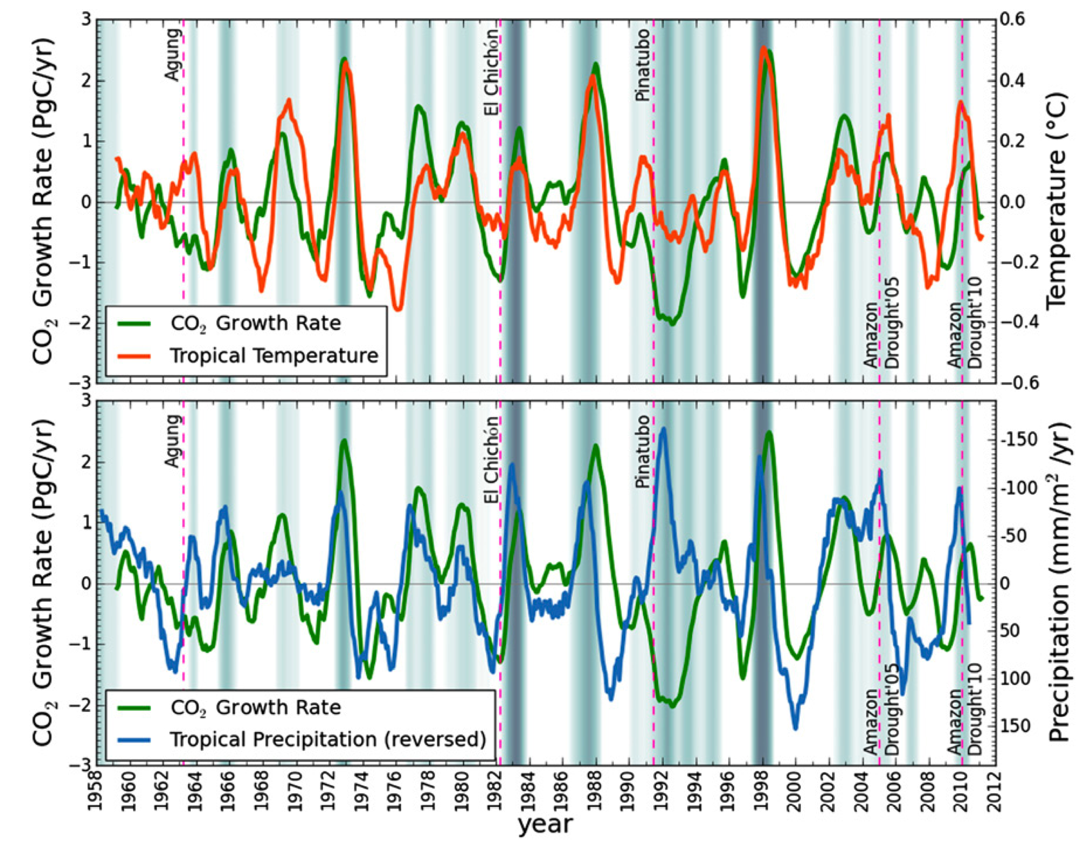
Link between tropical temperatures and CO₂ growth rate
Wang et al, 2013 (PNAS) showed that 1 °C tropical temperature anomaly leads to a 3.5 ± 0.6 PgC yr⁻¹ CO2 growth rate anomaly (1959-2011) (r² ≈ 0.5).
Cox et al, 2013 (Nature)
used that same relationship
to apply an observational constraint
on carbon-cycle climate feedback
parameter-> γ (GtC K⁻¹) in C⁴MIP models
Spatially explicit drivers of atmospheric CO2 growth rate and ancillary species could provide better process scale constraints

Slide 17
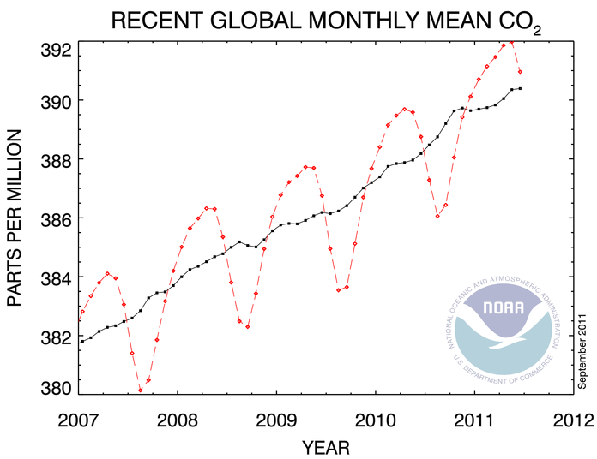
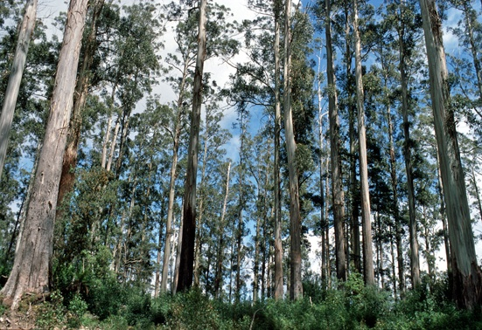

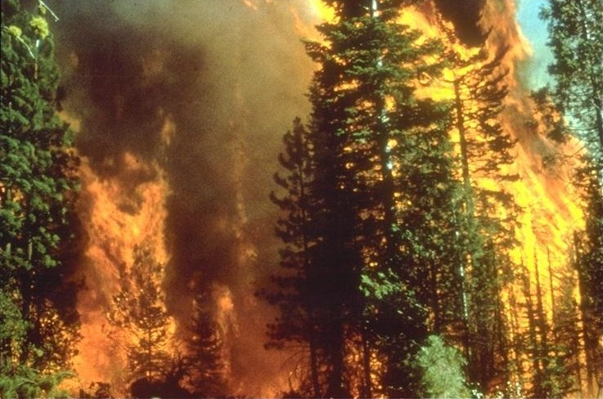
Attribution Strategy
A priori carbon cycle budgets
are constructed to be consistent with
atmospheric CO2 growth
CO2 accumulation
2010 2.44 ppm yr⁻¹
2011 1.84 ppm yr⁻¹
9.25 PgC yr⁻¹ (2010)
9.50 PgC yr⁻¹ (2011)
≈
-
4.85 - 2.92 PgC y⁻¹(2010)
5.79 - 2.24 PgC y⁻¹(2011)
-
2.38 (2010) PgC y⁻¹
2.71 (2011) PgC y⁻¹
Derived from ECCO-2 ocean flux estimate
Fossil Fuel (FFDAS)
Incorporates separate chemical CO2 production, aviation, bunker, and shipping
(Nassar et al, 2010)
Land-use change and river export are not included

Slide 18
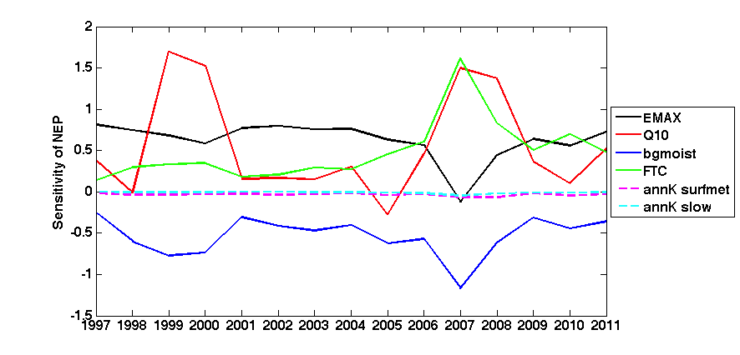
CASA-GFED3 terrestrial eco-system model
The CASA-GFED3 model is modified to have an annual flux consistent with the inferred terrestrial flux.
Spatial uncertainties are estimated through a Monte Carlo analysis through perturbation of key environmental parameters such as maximum potential light use efficiency, Q10, forest tree cover, etc.
  Quantifies parameteric uncertainty (but not structural uncertainty)
Interannual sensitivity of global NEP (no fire) to selected CASA-GFED parameters.
Courtesy J. Collatz
Notes:
Figure 2. Interannual sensitivity of global NEP (no fire) to selected
CASA-GFED parameters. Note fluxes are insensitive to fast and slow
Carbon Turnover rates (annK surfmet fast, annK slow slow).
Emax is the maximum potential light use efficiency as in
NPP=Emax x temp scalar x moisture scalare x fpar x par
Q10 is the respiration temperature response parameter such that respiration goes up in the baseline case by 150% for a 10 degree increase in temp
FTC is the fraction of a grid cell that is tree cover. this parameter is most important in determining how much NPP we allocated to wood.
annK surfmet is the turnover rate for the surface metabolic litter pool, one of 4 soil surface litter pools, it's turnover time is short <1year
annK slow is the turnover rate for the soil carbon pool referred to as slow and has a turnover time of 5 years.
Assumed normally distributed pdf for each parameter:
20% standard deviation on EMAX (0.4-0.6 gC MJ⁻¹), Q10 (1.2-1.8),
bgmoist (+/- 0.2), and 10% on wood allocation (+/- 0.1), and 25% on
wood turnover (0.02-0.03yr⁻¹). Wood turnover or mortality has little
Impact on the fluxes but large impact on estimated biomass.
These standard deviation estimates were derived from, literature
Surveys and expert opinions.

Slide 19
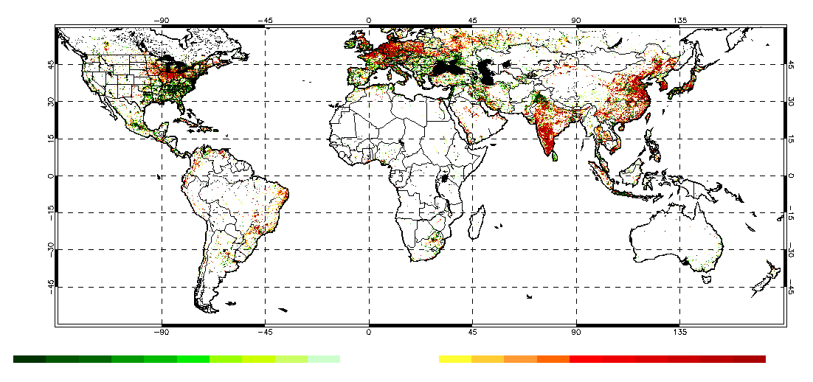
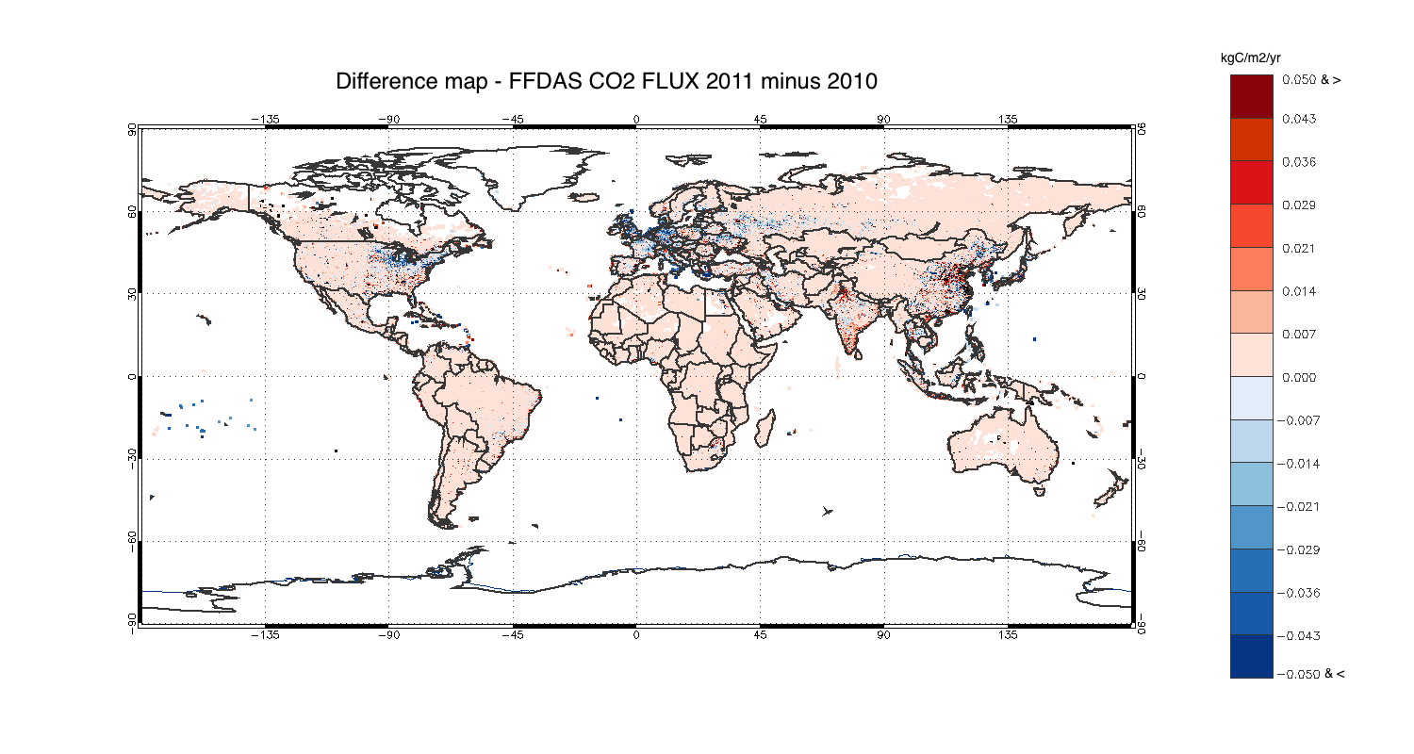
FFDAS-Fossil Fuel fluctuations
2010 Fossil fuel CO₂
Emission anomalies from historic mean
Recovery with subnational variation
negative
positive
Reduction of NE US and
Europe relative to 2010.
Increases in SE US, Northern India,
and Eastern China

Slide 20
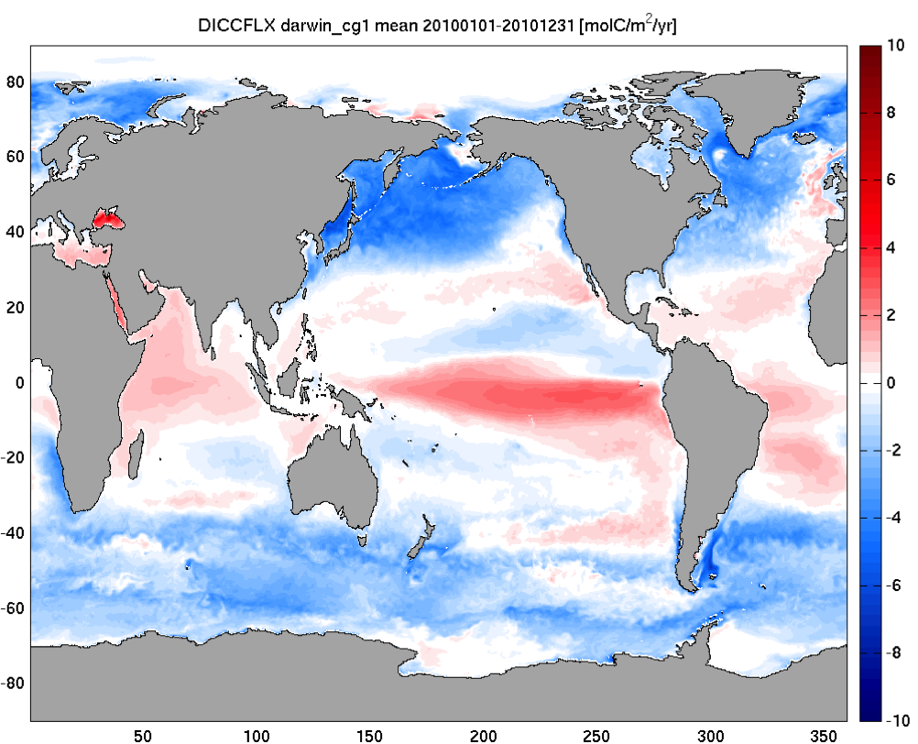
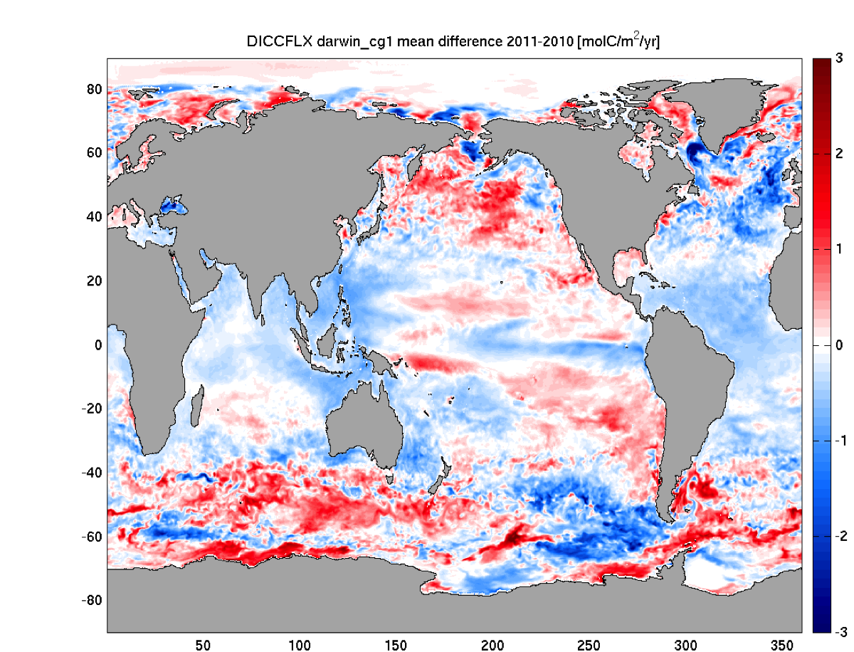
ECCO2-Darwin 4D-var Ocean Estimate
ECCO2-Darwin flux estimates are based on
an 18-km 4D-var physical ocean state estimate and
a Green’s Functions estimate of ocean biogeochemistry.
ECCO2-Darwin estimates show greater uptake in 2011 in the Indian and Atlantic Oceans and
A more complex structure in the Pacific and the extra tropics

Slide 21
Comparison to GOSAT v3.3
: -0.20
: 0.06 ppm
: 0.13
Consistent prior overestimate during the NH summer 2010-2011. This difference is dominated by the northern high latitudes.
: 0.29
The NH subtropics and midlatitude residuals
are underestimated and overestimated in the spring and summer, respectively.
Tropical carbon is underestimated for both winter and spring. High variability due to sampling
: -0.01
The SH is underestimated in Aug-Oct 2010
and March-May 2011.

Slide 22
Tropical Driver of the Atmospheric Growth Rate
The tropics (23S-23N) dominate the change in atmospheric growth
rate:
30%: Biomass burning
15%: Ocean

Slide 23
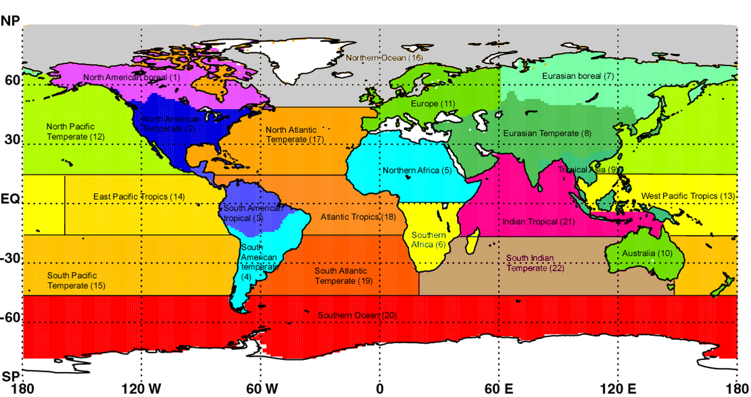
Regional Flux Change (2011-2010)
African fluxes contribute the largest to the
tropical signal
The tropical SouthEast Asian flux of ~-0.3 PgC was dominated by regions including Cambodia, Laos, Vietnam, Myanmar
Amazon basin (20S-5N,80W-35W) is ~-0.4 PgC, similar to -0.42 PgC from Gatti et al, Nature (2014)
Mexico flux change was 0.18 PgC, ~70%
of North American Temperate

Slide 24
Conclusions
The tropics dominate the 2010-2011 flux change through a complex spatial pattern of oceanic, terrestrial, and fire fluxes
  Consistent with temperature-growth rate correlations in Wang et al (2013) and Cox et al (2013)
  However, increases in positive NH fluxes from fossil fuel and terrestrial ecosystems partially offset the SH change.
  Biomass burning contributed about 30% to tropical signal estimate
  Ocean contributed about 15% to the tropical signal
  Tropical Amazon flux broadly consistent with aircraft and surface observations
South America Tropical, Mexico, Southeast Asia have responses consistent with precipitation anomalies
  Wang et al, Nature (2014) suggested a stronger temperature response under strong drought conditions
Africa has the strongest response
  Needs further investigation
  Zhou et al, Nature (2014) pointed to a large scale decline in greeness in the Congo basinMore information at http://carbon.nasa.gov and http://cmsflux.jpl.nasa.gov

Slide 25
Linking the subtropics to the tropics
The tropical changes in flux are driven by non-local observations.
Transport connects the subtropics to the tropics.

Slide 26
Summertime….when the sampling is easy
GOSAT NH Summertime is a maximum of local sampling and biological activity
The NH and SH subtropics are well sampled through the year
…..so is North America

Slide 27
Fossil Fuel Data Assimilation System
FFDAS is a data assimilation system based on a series of observational proxies within a dynamical model of energy consumption (S. Asefi-Najafabady et al, JGR submitted).
0.1 degrees, hourly, 1997 to 2011.
Incorporates the Temporal Improvements for Modeling Emissions by Scaling (TIMES) climatology from Nassar et al, JGR, 2012

Slide 28
Spatial driver of the CO2 growth rate
2.44 ppm yr⁻¹
1.84 ppm yr⁻¹
The largest contribution spatially to the CO2 growth rate is China’s Eastern seaboard (>0.12 ppm yr⁻¹).
Southeast Asia contributed 20-30 ppb yr⁻¹ more to the atmospheric growth in 2010 than in 2011 where the total flux is nearly neutral.
Subequatorial Africa flux attenuated the growth rate more in 2011 than in 2010.

Slide 29
BACKUP

Slide 30
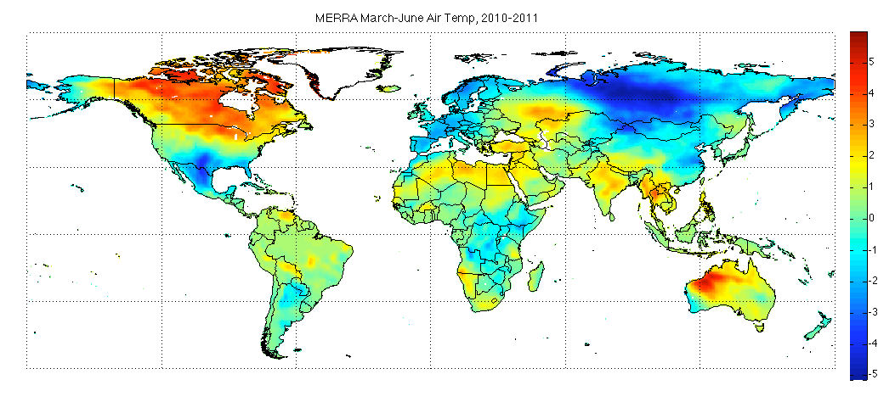
NH temperature response
The temperature response in the
northern latitudes in less clear
European uptake change follows temperature change
Weak response in Canada and Russia in spite significant
anomalies
There are few GOSAT measurements north of 60
MERRA March-June, 2010-2011
Temperature

Slide 31
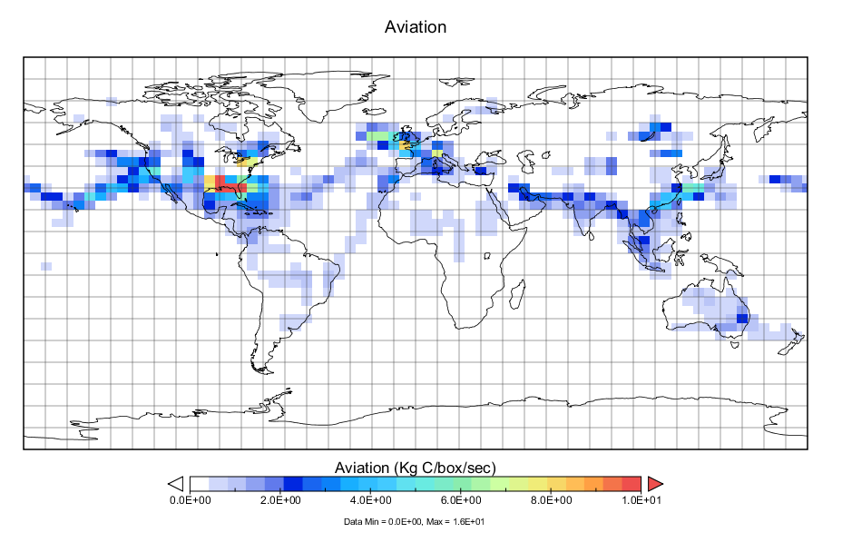
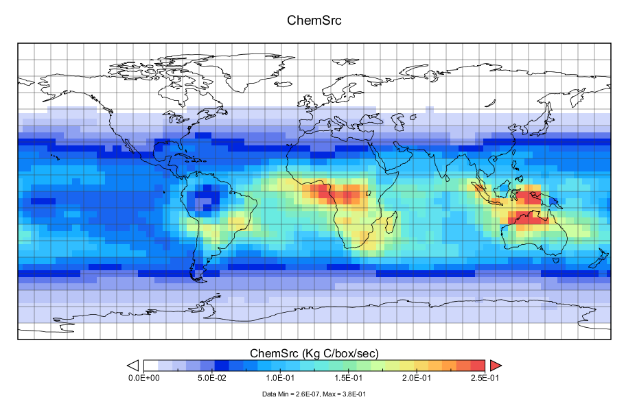
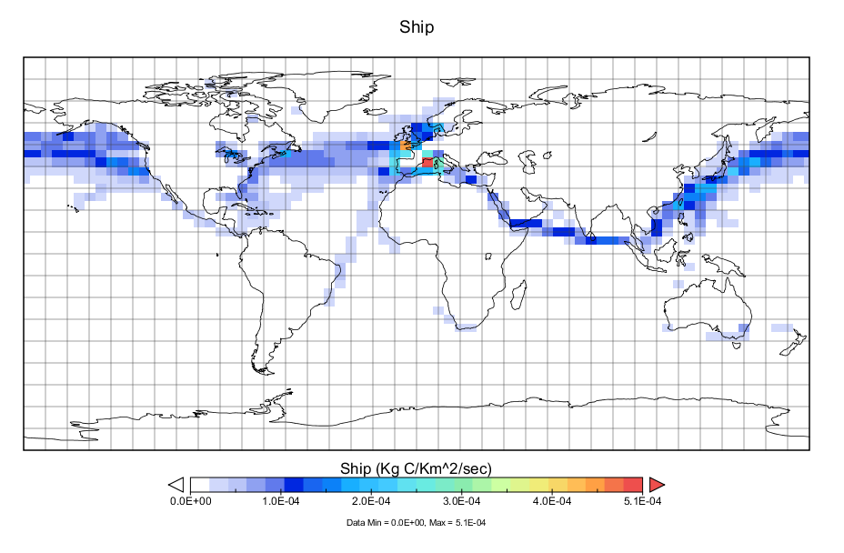
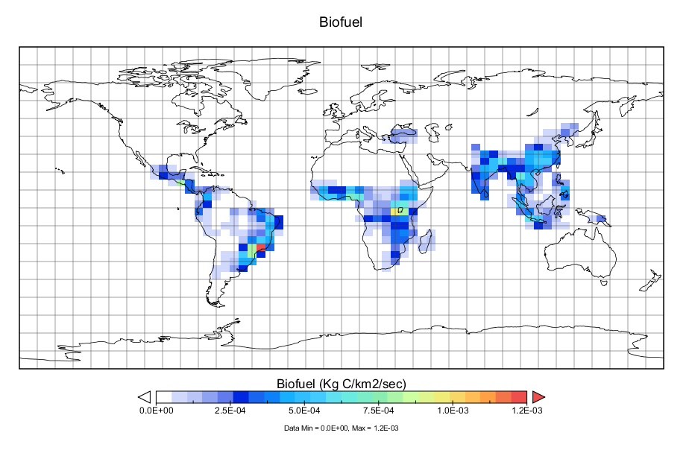
Anthropogenic emissions
Nassar et al, Geo. Mod. Dev., 2010

Slide 32
CASA-GFED NEE uncertainty: role of the tropics

Slide 33
ECCO2-Darwin 4D-var Ocean Estimate
ECCO2-Darwin flux estimates are based on
an 18-km 4D-var physical ocean state estimate and
a Green’s Functions estimate of ocean biogeochemistry.
Regional ECCO2-Darwin ocean uptake is consistent with previous observational and model-based estimates.
ECCO2-Darwin estimates show greater uptake in 2011 in the Indian and Atlantic Oceans and
A more complex structure in the Pacific and the extra tropics

Slide 34
ECCO2-Darwin ocean biogeochemical model
ECCO2: Eddying Global-Ocean and Sea-­Ice Data Synthesis
18 km-cubed sphere, physical ocean 4D-­‐variational assimilation
(Menemenlis et al, 2008)
Darwin: Ocean Biogeochemistry (Follows et al., 2007)
Biogeochemistry is constrained
by a Green’s function approach
(least squares)
Model: y - G [x_{b}] ≈ G (x - x_{b}) + n
Solution:
x = x_{b} + (G^{T}G)⁻¹ G^{T} (y - G [x_{b}])
G is a kernel matrix whose columns are computed using a GCM sensitivity experiment for each parameter in vector x, which are the initial conditions. Subscript “b” represents baseline GCM integration used to linearize problem.
Concentration of different species categories
Diatoms (red), Prochlorococus (green)
Picoplankton (blue), Everything else (yellow)
Notes:
The ECCO2 ocean solution assimilates a variety of satellite and in-situ data, including Jason altimetry, AMSRE-E sea surface temperature, and Argo temperature and salinity profiles.
The spatial resolution of ECCO2-Darwin in our set-up is about 1/6 of a degree or 18km globally on a cube sphere grid. NOBM is extending from near the South Pole to 72° N, in increments of 2/3 deg latitude and 1 1/4 deg longitude.

Slide 35
4D-var assimilation approach
State vector
q₀
Initial conditions
q_{a}
Flux
e₁
e₂
e₃
Both an initial condition and boundary condition problem
Initial conditions solved through “sliding window” technique from Feng and Jones (UT)
Monthly NEE estimated over a year window.
Estimate of terrestrial flux only
4D-var
x: monthly scale factor
[S_{a}]_{ii} = CASA-GFED3 Monte Carlo
S_{n} = Observational error from
ACOS. No transport error or
horizontal correlation error.

